Slide 1
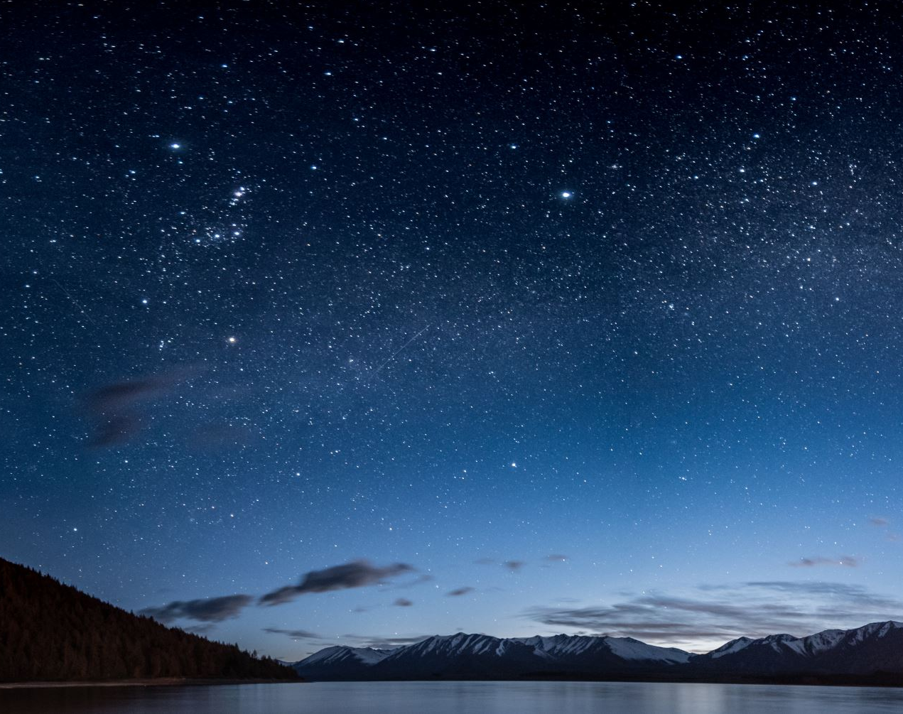
Million Euro Drop
2.13 Financial Statements

Slide 2
Question 1 An income statement is...
A - made up of 3 accounts – 1. Trading Account, 2. Profit and loss account and 3. the Appropriation account.
B- a section to calculate the gross profit (or loss) of the company.
C- also known as the expense section and is used to calculate the net profit.
D – is a section that shows how much dividend were given to shareholders and how much reserves (money left over) the company has.

Slide 3
Answer An income statement is...
A - made up of 3 accounts – 1. Trading Account, 2. Profit and loss account and 3. the Appropriation account.

Slide 4
Question 2 A trading account is...
A - made up of 3 accounts – 1. Trading Account, 2. Profit and loss account and 3. the Appropriation account.
B- a section to calculate the gross profit (or loss) of the company.
C- also known as the expense section and is used to calculate the net profit.
D – is a section that shows how much dividend were given to shareholders and how much reserves (money left over) the company has.

Slide 5
Answer The trading account is...
B- This section calculate the gross profit (or loss) of the company.

Slide 6
Question 3 A profit or loss account is...
A - made up of 3 accounts – 1. Trading Account, 2. Profit and loss account and 3. the Appropriation account.
B- a section to calculate the gross profit (or loss) of the company.
C- also known as the expense section and is used to calculate the net profit.
D – is a section that shows how much dividend were given to shareholders and how much reserves (money left over) the company has.

Slide 7
Answer A profit or loss account is...
C- also known as the expense section and is used to calculate the net profit

Slide 8
Question 4 An appropriation account is...
A - made up of 3 accounts – 1. Trading Account, 2. Profit and loss account and 3. the Appropriation account.
B- a section to calculate the gross profit (or loss) of the company.
C- also known as the expense section and is used to calculate the net profit.
D – is a section that shows how much dividend were given to shareholders and how much reserves (money left over) the company has.

Slide 9
Answer An appropriation account is...
D – is a section that shows how much dividend were given to shareholders and how much reserves (money left over) the company has.

Slide 10
Question 5 Net Profit is...
A - when the expenses are less than the Gross Profit
B- when the expenses are greater than Gross Profit
C- the money that is spent on items that will last for a long time in the business. These items are also known as fixed assets and include – Premises
D – day to day expenses and are used to run the company. They are also known as revenue expenditure and examples include Wages.

Slide 11
Answer Net Profit is...
A - when the expenses are less than the Gross Profit

Slide 12
Question 6 Net Loss is...
A - when the expenses are less than the Gross Profit
B- when the expenses are greater than Gross Profit
C- the money that is spent on items that will last for a long time in the business. These items are also known as fixed assets and include – Premises
D – day to day expenses and are used to run the company. They are also known as revenue expenditure and examples include Wages.

Slide 13
Answer Net Loss is...
B- when the expenses are greater than Gross Profit

Slide 14
Question 7 Capital Expenditure is...
A - when the expenses are less than the Gross Profit
B- when the expenses are greater than Gross Profit
C- the money that is spent on items that will last for a long time in the business. These items are also known as fixed assets and include – Premises
D – day to day expenses and are used to run the company. They are also known as revenue expenditure and examples include Wages.

Slide 15
Answer Capital Expenditure is...
C- the money that is spent on items that will last for a long time in the business. These items are also known as fixed assets and include – Premises

Slide 16
Question 8 Current Expenditure is...
A - when the expenses are less than the Gross Profit
B- when the expenses are greater than Gross Profit
C- the money that is spent on items that will last for a long time in the business. These items are also known as fixed assets and include – Premises
D – day to day expenses and are used to run the company. They are also known as revenue expenditure and examples include Wages.

Slide 17
Answer Current Expenditure is...
D – day to day expenses and are used to run the company. They are also known as revenue expenditure and examples include Wages.

Slide 18
Question 9 Capital Structure is/are...
A - the money that the business is given. It can come from a loan, selling shares or retained earnings
B- items that a business has for long term use. They depreciate over time and include premises, Machinery, fixture and fittings.
C- assets that can be quickly converted into cash – usually within one year. Example include – Closing Stock, Debtors, Cash and bank
D – short-term debts owed by the business. They include Bank overdraft, Unpaid bills and Creditors

Slide 19
Answer Capital Structure is/are...
A - the money that the business is given. It can come from a loan, selling shares or retained earnings

Slide 20
Question 10 Fixed assets are...
A - the money that the business is given. It can come from a loan, selling shares or retained earnings
B- items that a business has for long term use. They depreciate over time and include premises, Machinery, fixture and fittings.
C- assets that can be quickly converted into cash – usually within one year. Example include – Closing Stock, Debtors, Cash and bank
D – short-term debts owed by the business. They include Bank overdraft, Unpaid bills and Creditors

Slide 21
Answer Fixed assets are...
B- items that a business has for long term use. They depreciate over time and include premises, Machinery, fixture and fittings.

Slide 22
Question 11 Current assets are...
A - the money that the business is given. It can come from a loan, selling shares or retained earnings
B- items that a business has for long term use. They depreciate over time and include premises, Machinery, fixture and fittings.
C- assets that can be quickly converted into cash – usually within one year. Example include – Closing Stock, Debtors, Cash and bank
D – short-term debts owed by the business. They include Bank overdraft, Unpaid bills and Creditors

Slide 23
Answer Current assets are...
C- assets that can be quickly converted into cash – usually within one year. Example include – Closing Stock, Debtors, Cash and bank

Slide 24
Question 12 Creditiors falling due within one year are...
A - the money that the business is given. It can come from a loan, selling shares or retained earnings
B- items that a business has for long term use. They depreciate over time and include premises, Machinery, fixture and fittings.
C- assets that can be quickly converted into cash – usually within one year. Example include – Closing Stock, Debtors, Cash and bank
D – short-term debts owed by the business. They include Bank overdraft, Unpaid bills and Creditors

Slide 25
Answer Creditiors falling due within one year are...
D – short-term debts owed by the business. They include Bank overdraft, Unpaid bills and Creditors

Slide 26
Question 13 Working Capital is ...
A - the different between Current Assets and Creditors failing due within one year. It also set out the liquidity of the business.
B - the net worth of the business and is calculate by adding the Fixed assets to the working capital.
C - made up of Long-term loans, share capital (Authorised and Issued) and Closing reserve form the Income Statement
D – the money that is invested into a business and used to generate income.

Slide 27
Answer Working Capital is ...
A - the different between Current Assets and Creditors failing due within one year. It also set out the liquidity of the business.

Slide 28
Question 14 Total Net Assest are ...
A - the different between Current Assets and Creditors failing due within one year. It also set out the liquidity of the business.
B - the net worth of the business and is calculate by adding the Fixed assets to the working capital.
C - made up of Long-term loans, share capital (Authorised and Issued) and Closing reserve form the Income Statement
D – the money that is invested into a business and used to generate income.

Slide 29
Answer Total Net Assest are ...
B - the net worth of the business and is calculate by adding the Fixed assets to the working capital.

Slide 30
Question 15 Capital Employed is ...
A - the different between Current Assets and Creditors failing due within one year. It also set out the liquidity of the business.
B - the net worth of the business and is calculate by adding the Fixed assets to the working capital.
C - made up of Long-term loans, share capital (Authorised and Issued) and Closing reserve form the Income Statement
D – the money that is invested into a business and used to generate income.

Slide 31
Answer Capital Employed is ...
C - made up of Long-term loans, share capital (Authorised and Issued) and Closing reserve form the Income Statement

Slide 32
Question 16 Capital is ...
A - the different between Current Assets and Creditors failing due within one year. It also set out the liquidity of the business.
B - the net worth of the business and is calculate by adding the Fixed assets to the working capital.
C - made up of Long-term loans, share capital (Authorised and Issued) and Closing reserve form the Income Statement
D – the money that is invested into a business and used to generate income.

Slide 33
Answer Capital is ...
D – the money that is invested into a business and used to generate income.

Slide 34
Question 17 Equity Capital is ...
A - money that is given by shareholders or profits that is put back into the business
B - money that the business raises from borrowing such as loans
C - the amount of finance a company can raise through the issue of shares
D – the amount of fiancé that the company has risen form issuing shares

Slide 35
Question 17 Equity Capital is ...
A - money that is given by shareholders or profits that is put back into the business

Slide 36
Question 18 Debt Capital is ...
A - money that is given by shareholders or profits that is put back into the business
B - money that the business raises from borrowing such as loans
C - the amount of finance a company can raise through the issue of shares
D – the amount of fiancé that the company has risen form issuing shares

Slide 37
Question 18 Debt Capital is ...
B - money that the business raises from borrowing such as loans

Slide 38
Question 19 Authorised Capital is ...
A - money that is given by shareholders or profits that is put back into the business
B - money that the business raises from borrowing such as loans
C - the amount of finance a company can raise through the issue of shares
D – the amount of fiancé that the company has risen form issuing shares

Slide 39
Question 19 Authorised Capital is ...
C - the amount of finance a company can raise through the issue of shares

Slide 40
Question 20 Issued Capital is ...
A - money that is given by shareholders or profits that is put back into the business
B - money that the business raises from borrowing such as loans
C - the amount of finance a company can raise through the issue of shares
D – the amount of fiancé that the company has risen form issuing shares

Slide 41
Question 20 Issued Capital is ...
D – the amount of fiancé that the company has risen form issuing shares

